Slide 1
Memory Management System with Linked list
Submitted To:- Submitted By:-
Ms. Dipti Bansal Ma’am Ashish Kumar(2245917)
Asad Jawaid(2246063)
Ariba Mahmood(2247130)
Ashu Kumari(2246169)
Aryan(2245916)

Slide 2


Slide 3
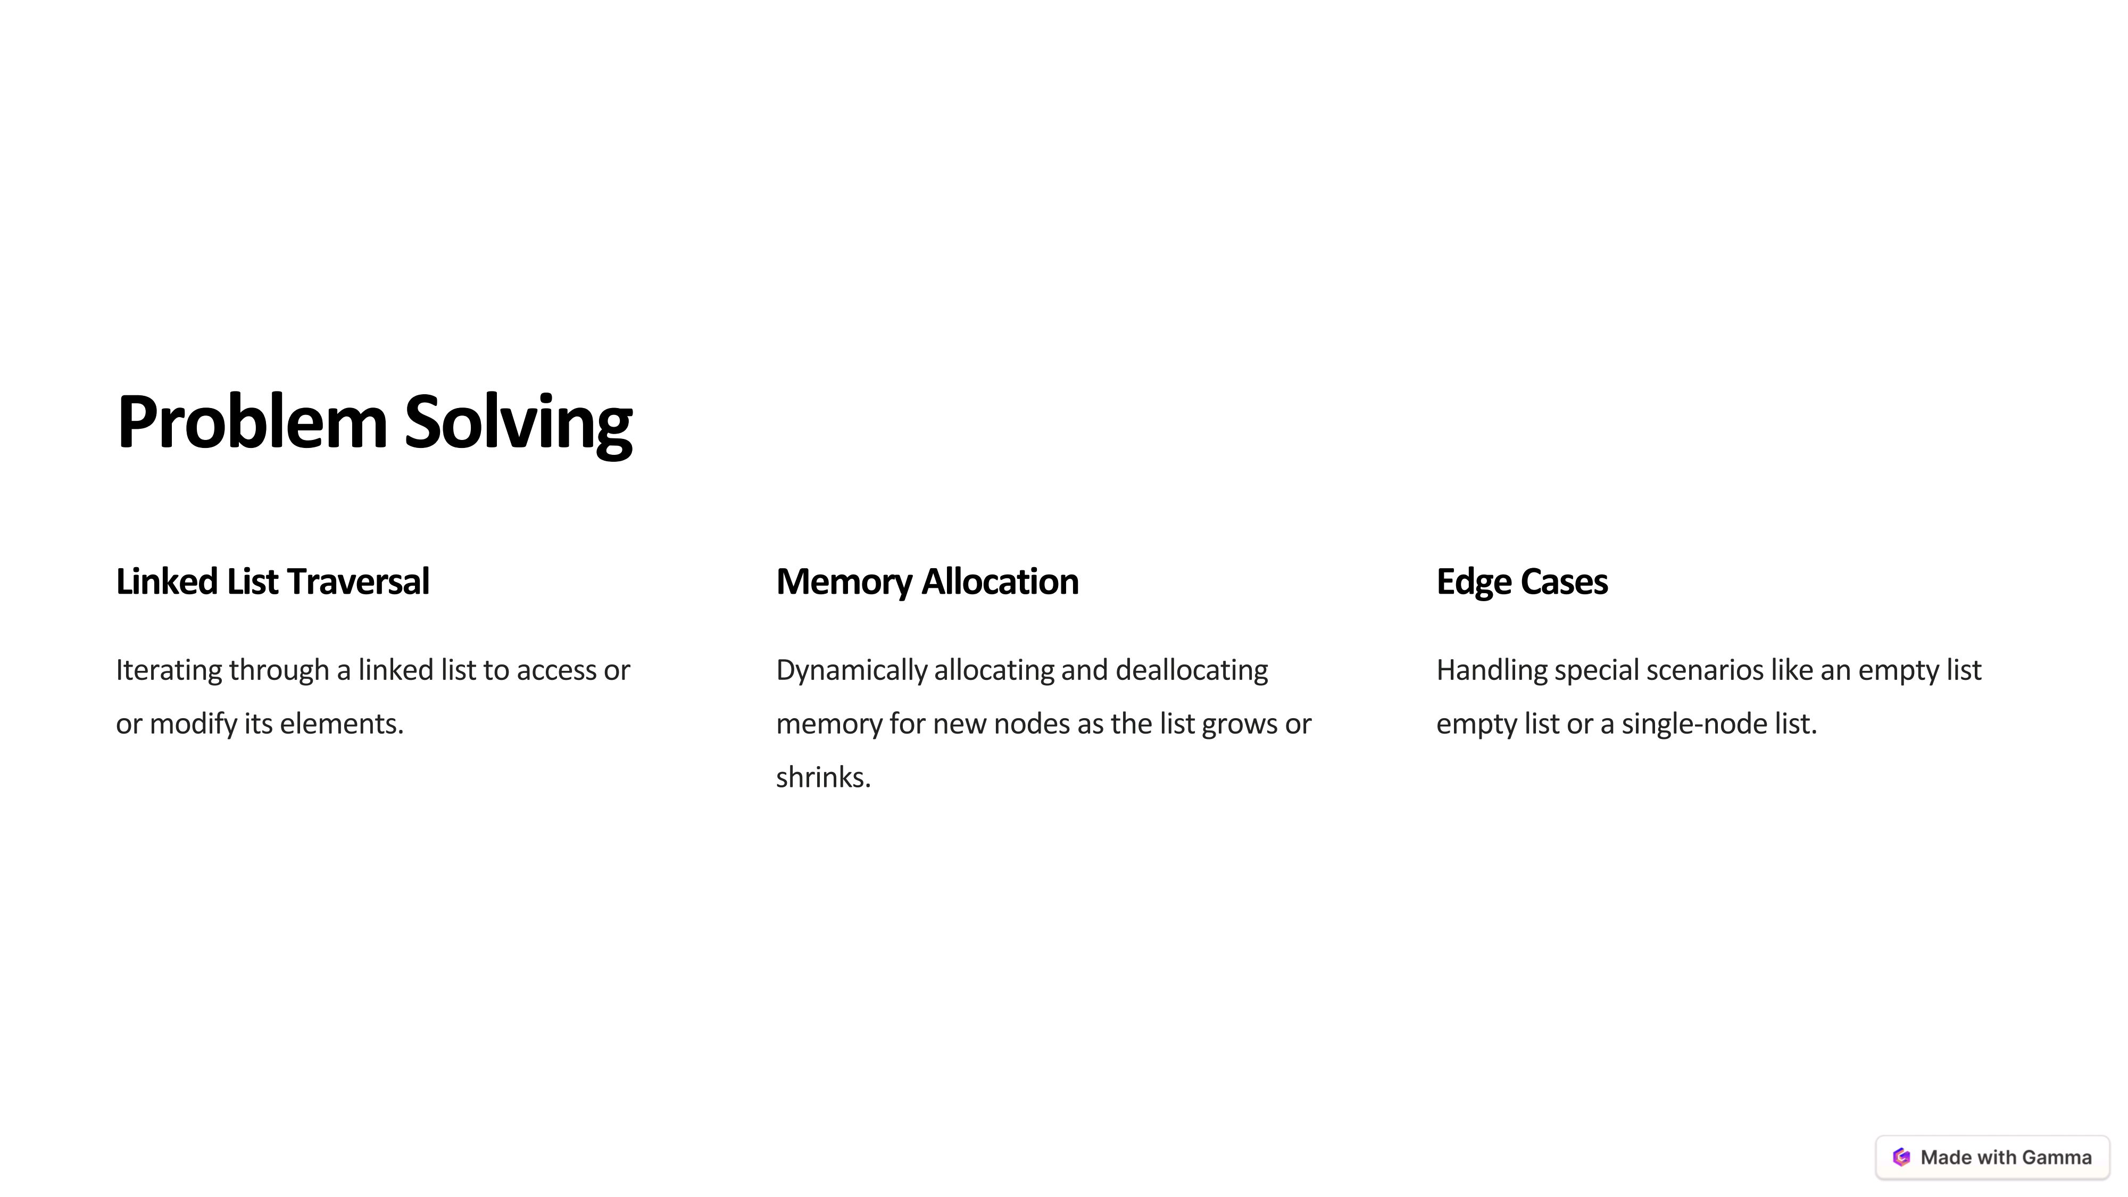

Slide 4
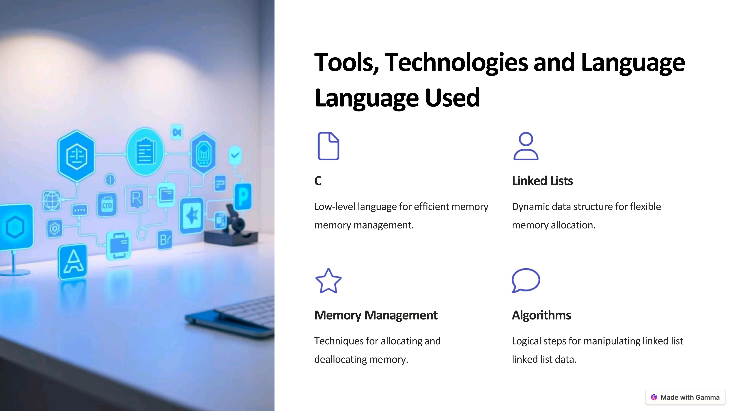

Slide 5
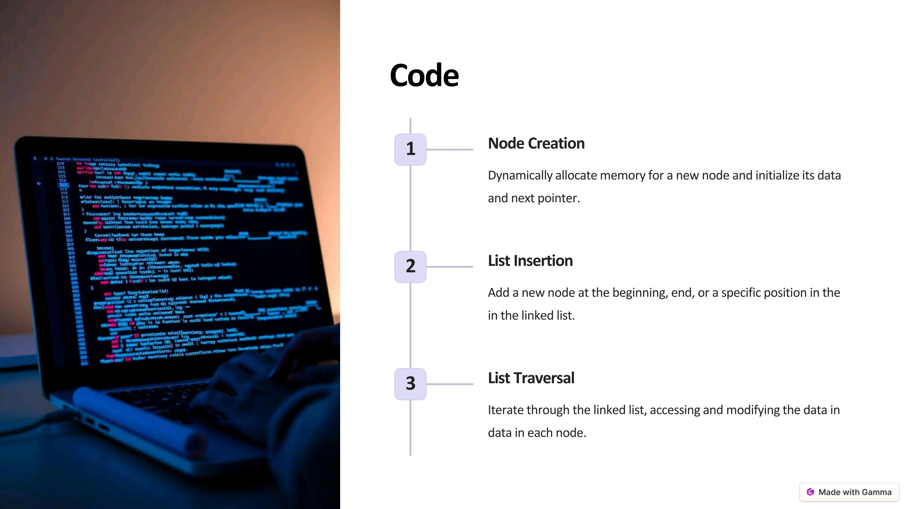

Slide 6
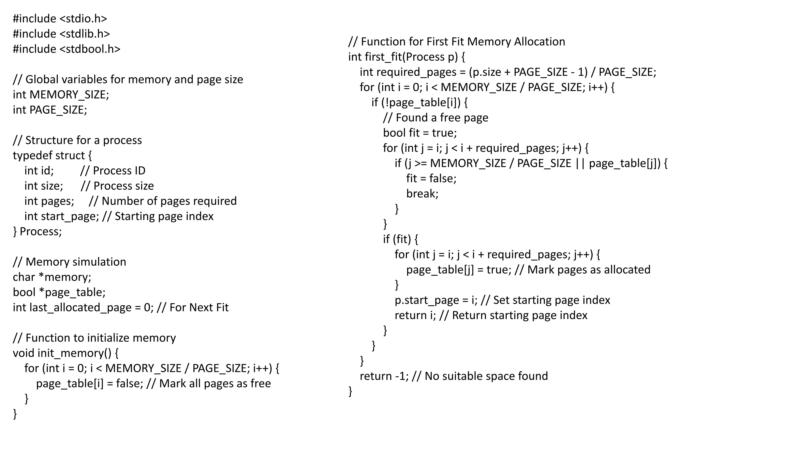

Slide 7
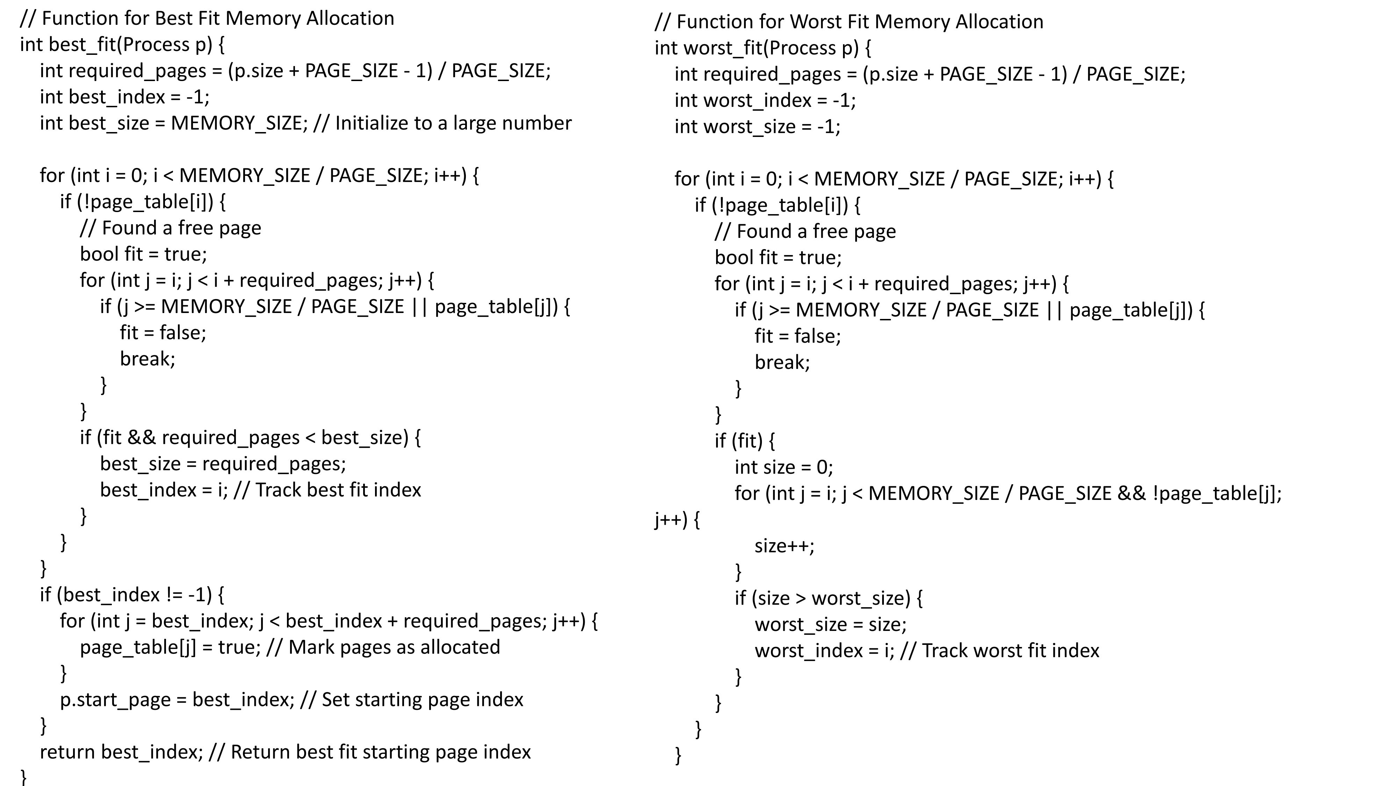

Slide 8
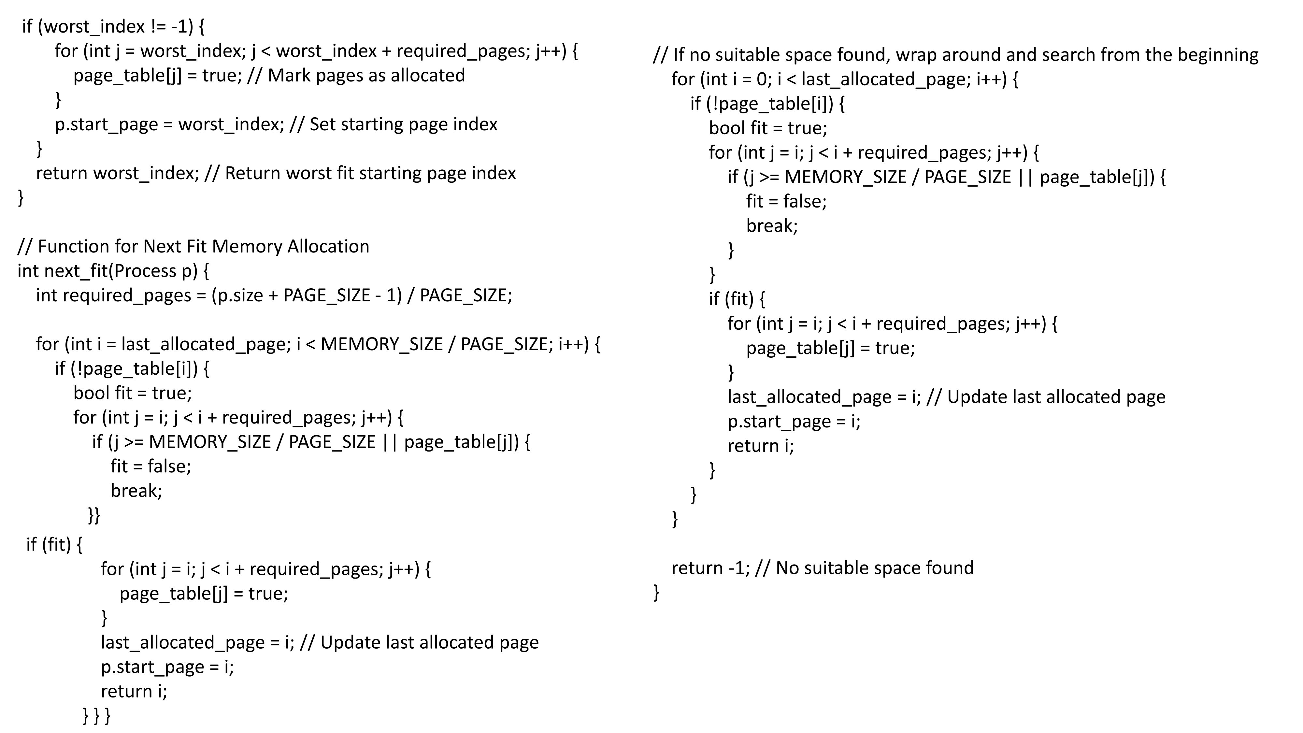

Slide 9
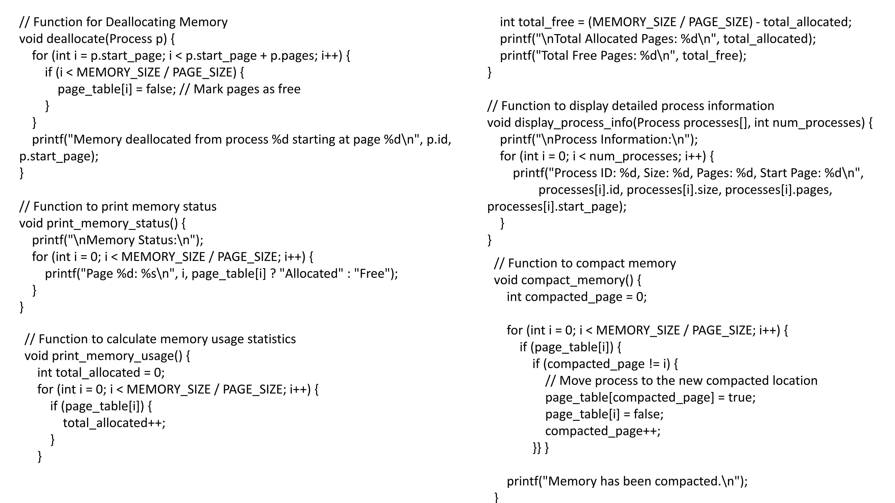

Slide 10
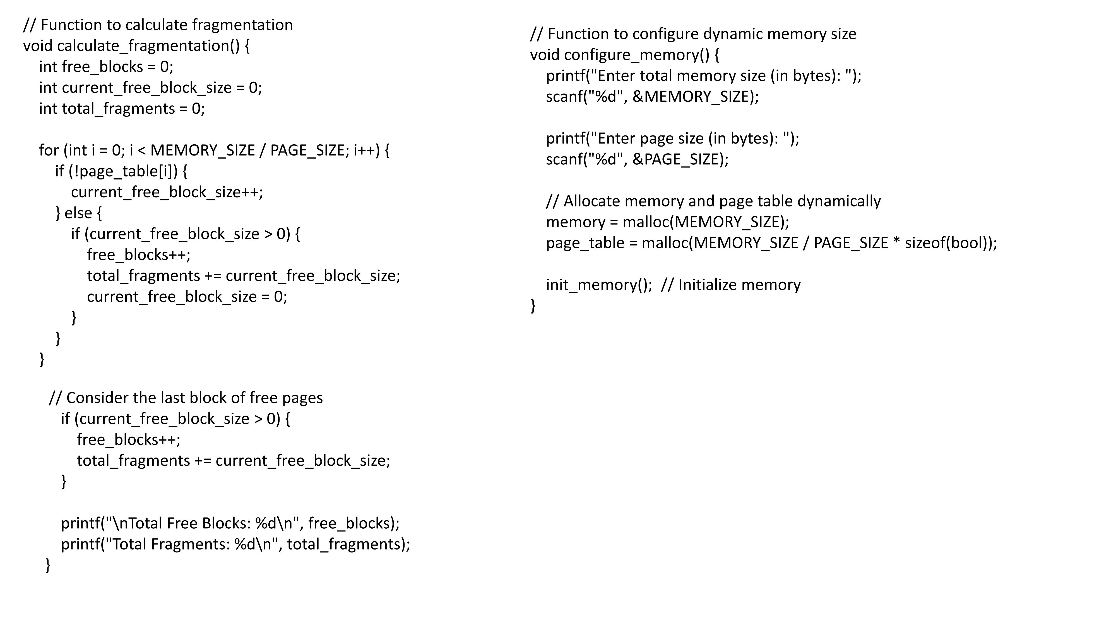

Slide 11
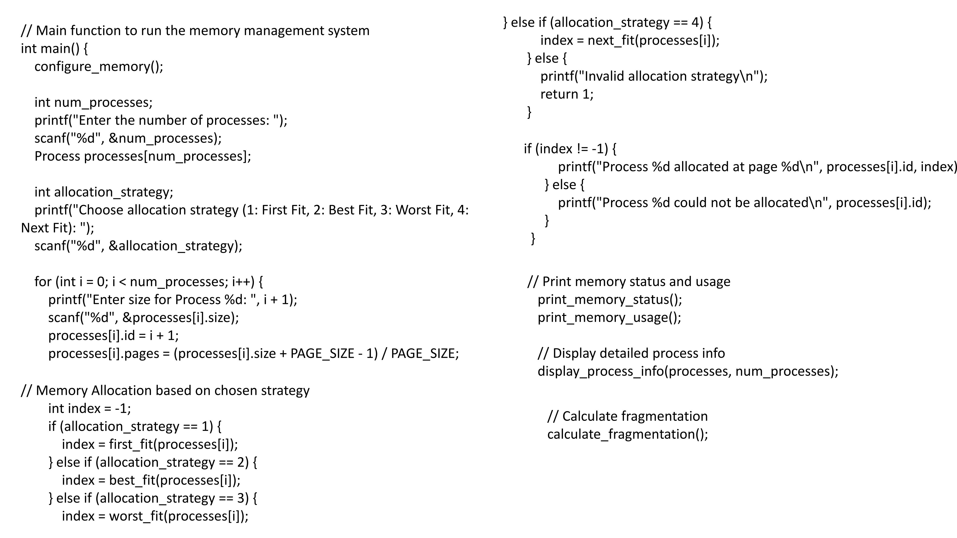

Slide 12
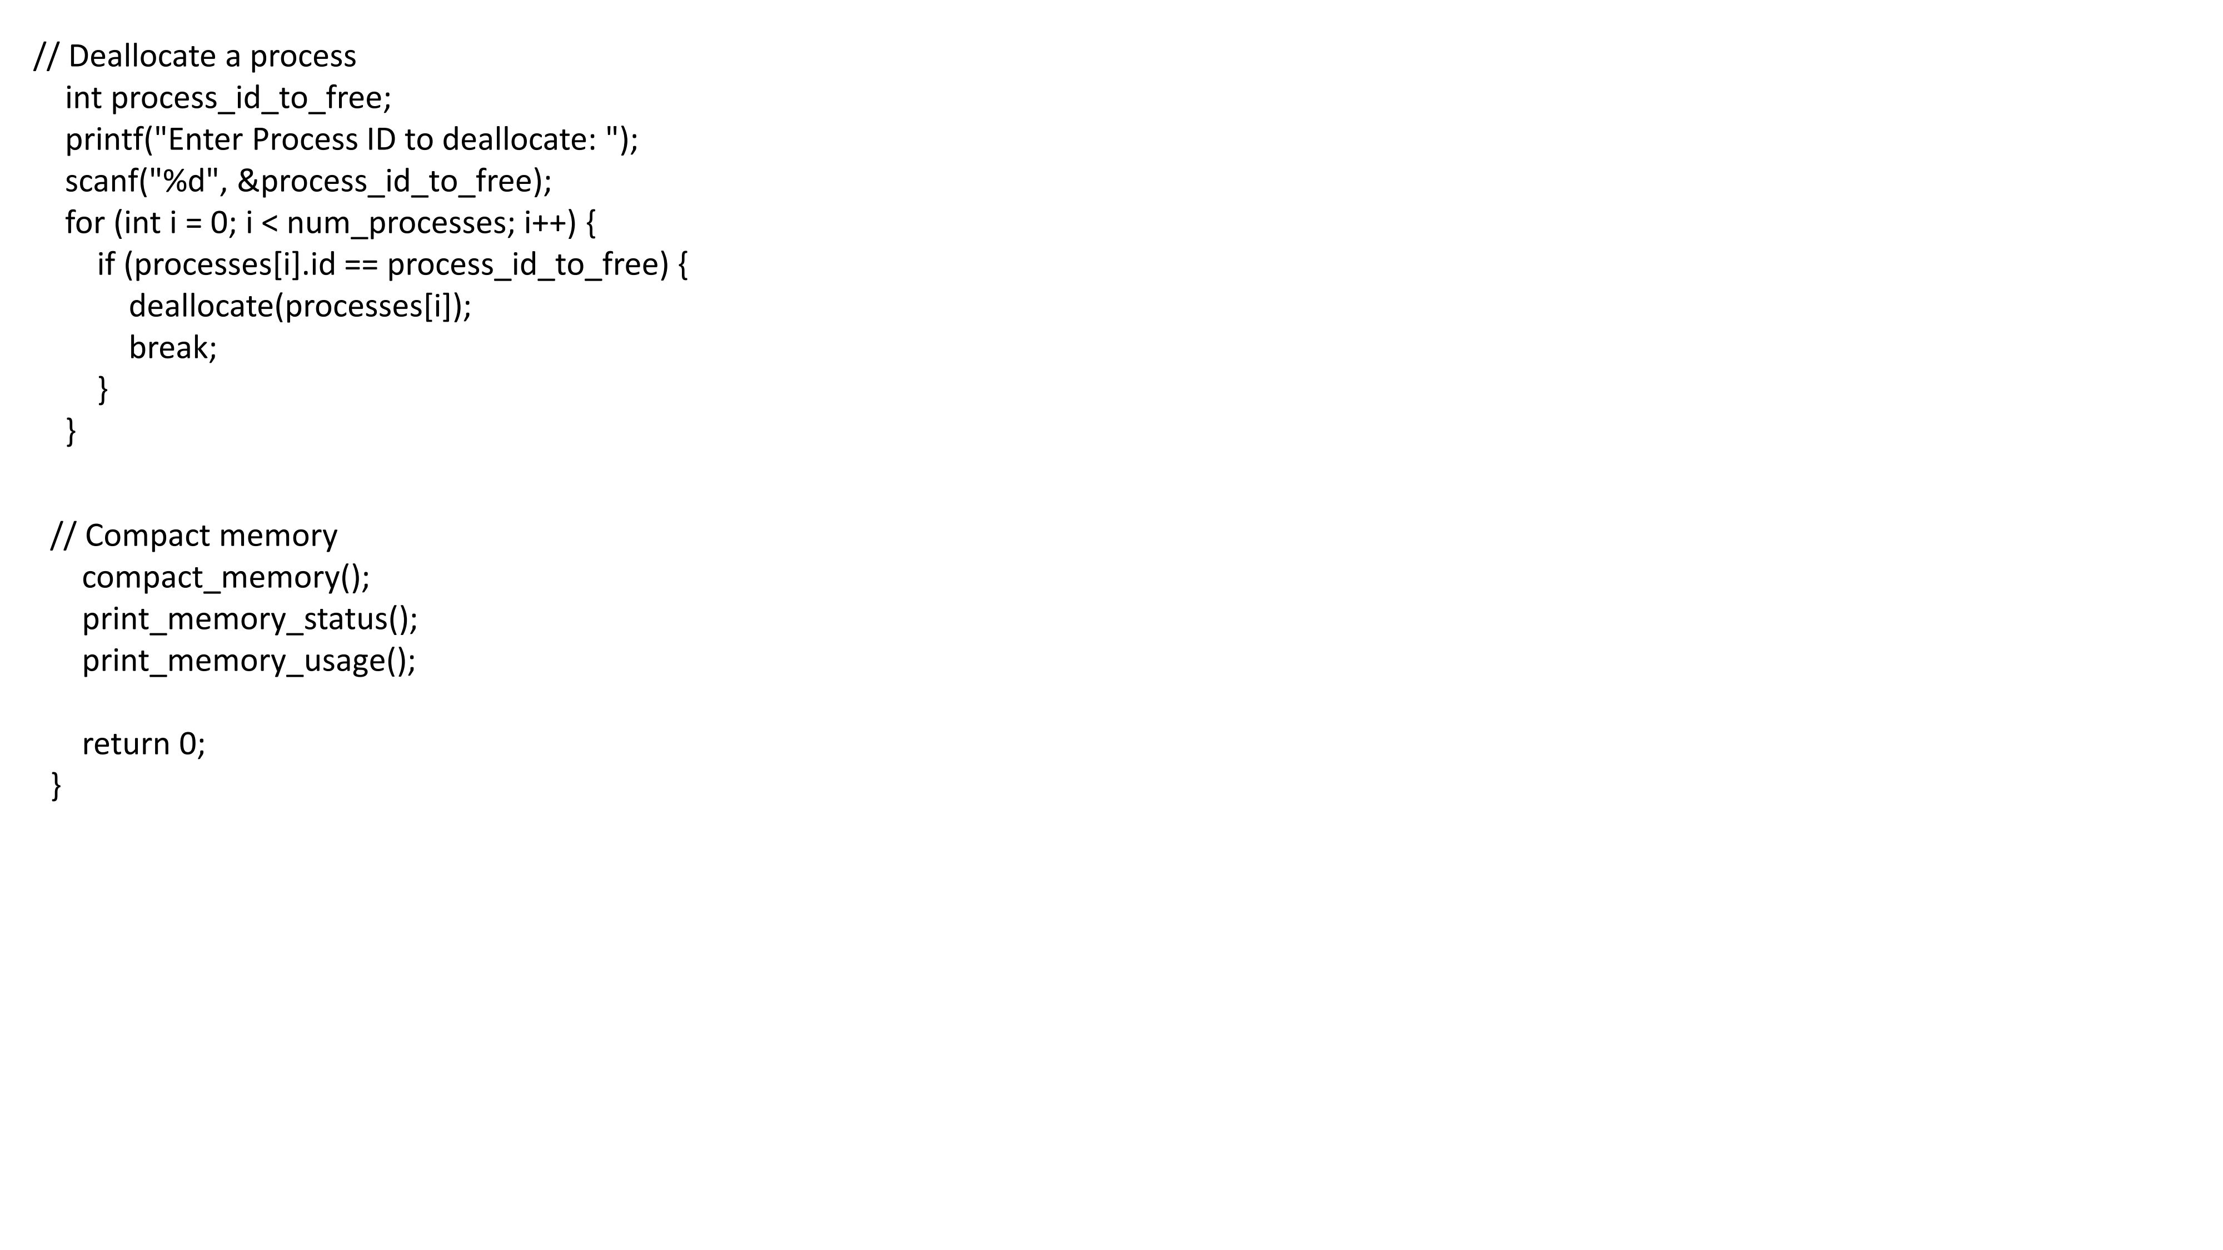

Slide 13
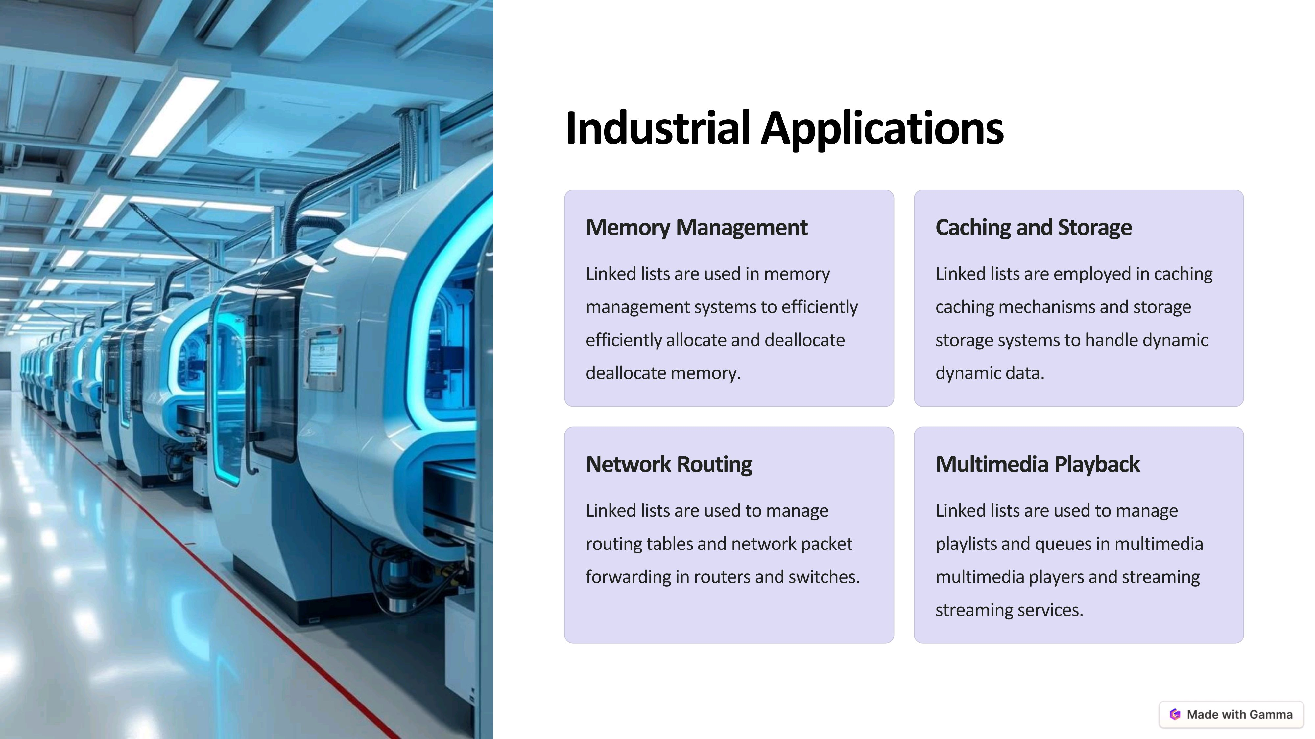

Slide 14
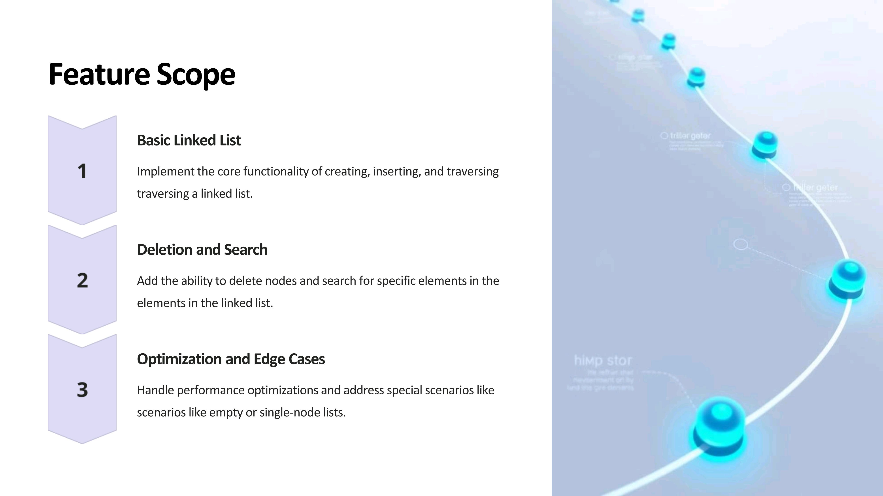

Slide 15


Slide 16


